Slide 1
Realism
Prepared By
Mrs Nadia Ali
Assistant Prof
Dept of International Relations

Slide 2
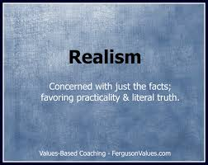

Slide 3
The tenets of realism go back several centuries and appear to many over time as eternal truths.
We see much commonality in both ancient and modern thinking about international relations.
Modern diplomacy is still often based on Realist theory.

Slide 4
Realism is a theory based on power politics
Main Assumptions:
States are most important actors
Unitary-Rational Decision-making
International system is anarchic and conflict-prone: often zero-sum situations
All States must pursue power to survive
States balance against threats
Morality has no place in international politics
International politics more important than domestic politics.
Value Relative over Absolute Gains

Slide 5
Basic Assumptions
Realism is a tradition of international theory centered upon four propositions.
The international system is anarchic.
There is no actor above states capable of regulating their interactions; states must arrive at relations with other states on their own, rather than it being dictated to them by some higher controlling entity.
The international system exists in a state of constant antagonism
States are the most important actors.
All states within the system are unitary, rational actors
States tend to pursue self-interest.
Groups strive to attain as many resources as possible
The primary concern of all states is survival.
States build up military to survive, which may lead to a security dilemma.

Slide 6
Realist
While realists are just as interested as idealists in conflict management, realists are less optimistic about the effectiveness of international law and organization and about the extent of international cooperation that is possible
Realists view international relations almost exclusively as a “struggle for power” among competing nation-states
States, like human beings, have an innate desire to dominate others

Slide 7
Realist
The ultimate goal of all countries is security in a hostile, anarchic environment
Realist policies are determined by power calculations in pursuit of national security
Countries satisfied with their situation tend to pursue the status quo
Countries that are dissatisfied tend to be expansionist
Alliances are made and broken based on the requirements of “realpolitik”

Slide 8
Realist
Realists focus on military strategy, the elements of national power, and the nature of national interests more so than international law and organization
From WWII they learned that the way to prevent future wars was a “balance of power” capable of deterring would-be aggressors or on a “concert of powers” willing to police the world

Slide 9
Chief Supports of Realism
Thucydides
Thomas Hobbes
Niccole Machiavelli
E.H. Carr
Hans J Morgenthau

Slide 10
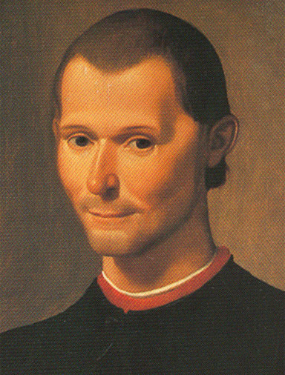
Realist
In the 16th Century Machiavelli had argued in The Prince that:
“it is far better to be feared than loved”
“he ought not to quit good courses if he can help it, but should know how to follow evil courses if he must”
“he will prosper most whose mode of acting best adapts itself to the character of the times; and conversely that he will be unprosperous, with whose mode of acting the times do not accord”

Slide 11
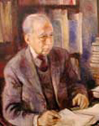
Realist
Hans Morgenthau is considered the father of realism
Wrote Politics Among Nations in 1948
Stressed the virtues of the classical, multipolar, balance of power system and saw the bipolar rivalry between the US and the USSR as especially dangerous

Slide 12
Morgenthau’s Six Principles
Politics is governed by objective laws that have their roots in human nature.
It is possible to develop a theory that reflects these laws and to differentiate between truth and opinion.
Therefore, we can predict what a state should rationally do.

Slide 13
Morgenthau’s Six Principles
Interest is defined in terms of power.
Interest defined as power is an objective category which is universally valid, but whose meaning can change.
Universal moral principles cannot be applied to the actions of states in the abstract; the circumstances of time and place must be considered.
The state must place its survival above all other moral goods.

Slide 14
Morgenthau’s Six Principles
The moral laws that govern the universe are distinct from the morals of any one nation.
Politics is an autonomous sphere that needs to be analyzed as an entity, without being subordinated to outside values.
Different facts of human nature exist, but the “political man” – the part of man interested only in power – is the appropriate facet for the study of politics.
Other standards are appropriate to other spheres, but not to politics.

Slide 15
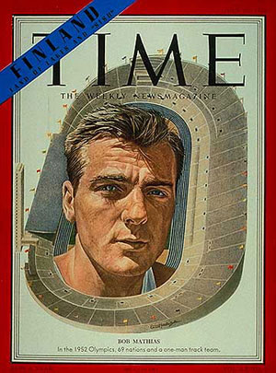
Realist
The realist paradigm was very popular during the Cold War
The US and the USSR competed in everything
Military
Economics
Space race
Olympics
Alliances
Bob Matthias, US competitor in the 1952 Olympics, said, the Russian athletes “were in a real sense the enemy. You just loved to beat them. You just had to beat them. It wasn’t like competing against some guys from a friendly country like Australia.”

Slide 16
Focus of Realism
Power
State
National Interest
State Survival

Slide 17
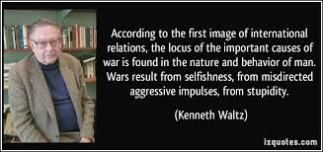
Theories generated from Realism
Neo-Realism
Structural Realism

Slide 18
What do you think about Realism?
Relevant or Accurate?
Logical?
Assumptions useful, such as unitary-rational actors?
Role of domestic politics?
Morality?
Does Anarchy really make conflict inevitable?

